Slide 1
Engs 31 / CoSc 56
DIGITAL ELECTRONICS
Today: Vahid, 5.7
  Block memory
Friday: VGA Timing
Notes:
Engs 31 / CoSc 56 — Digital Electronics
20. Block Memory 2

Slide 2
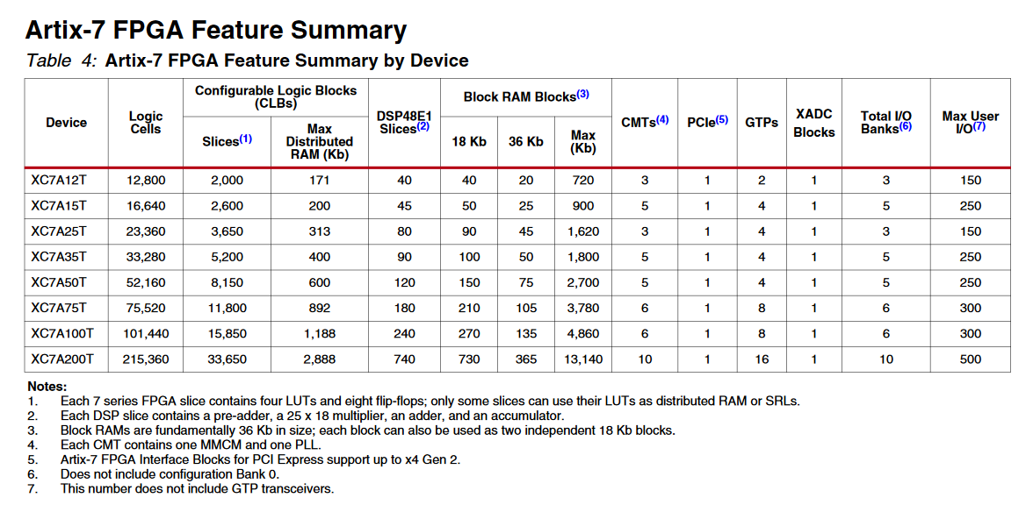
Review: FPGA memory

Slide 3
Block RAM on FPGA : via VHDL
Using a Xilinx-provided template for behavioral VHDL:
entity BlockRam1 is
port( Clk50 : in STD_LOGIC;
WE, RE : in STD_LOGIC;
addr, Din : in std_logic_vector (7 downto 0);
Dout : out STD_LOGIC_VECTOR (7 downto 0) );
end BlockRam1;
architecture Behavioral of BlockRam1 is
constant RAM_ADDR_BITS : integer := 8; -- 256 locations
constant RAM_WIDTH : integer := 8; -- 8 bits wide
type ram_type is array (2**RAM_ADDR_BITS-1 downto 0) of std_logic_vector (RAM_WIDTH-1 downto 0);
signal myRAM : ram_type;
begin
process ( Clk50 )
begin
if rising_edge(Clk50) then
if (RE = '1') then -- RAM is enabled
if (WE = '1') then -- Write Enable
myRAM( to_integer(unsigned(addr)) ) <= Din; -- Write
else
Dout <= myRAM( to_integer(unsigned(addr)) ); -- Read
end if;
end if;
end if;
end process;
end Behavioral;
Notes:
Engs 31 / CoSc 56 — Digital Electronics
20. Block Memory 2

Slide 4
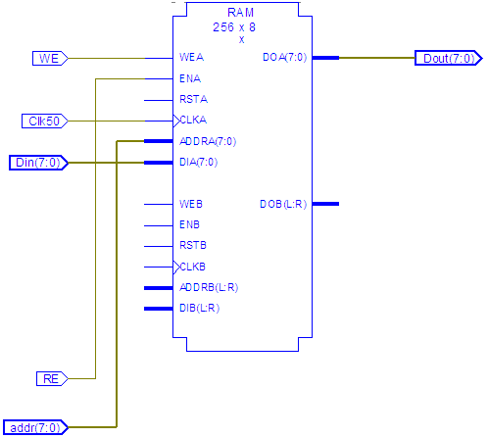
Block RAM on FPGA : RTL view
Notes:
Engs 31 / CoSc 56 — Digital Electronics
20. Block Memory 2

Slide 5
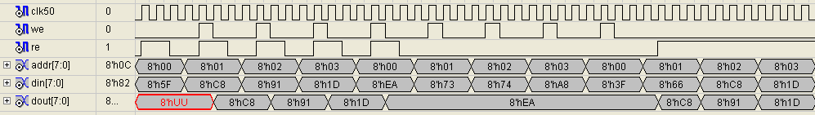
Block RAM on FPGA : simulation
Write, then read back
RAM disabled (RE=0)
Read only (WE=0)
Notes:
Engs 31 / CoSc 56 — Digital Electronics
20. Block Memory 2

Slide 6
Block RAM on FPGA : IP core
Core Ready-made block of logic that can be instantiated into a design, e.g., microprocessor, network interface, JPEG converter, but also smaller items like memories, fast arithmetic units, and FIFOs.
A core may consist only of VHDL code for a complex function, or it may be a netlist targeted to a particular FPGA architecture.
Sometimes also called a macro or parametrized module.
IP Intellectual property. There are companies that design and sell cores for particular FPGAs. They don’t sell hardware, per se.
Notes:
Engs 31 / CoSc 56 — Digital Electronics
20. Block Memory 2

Slide 7
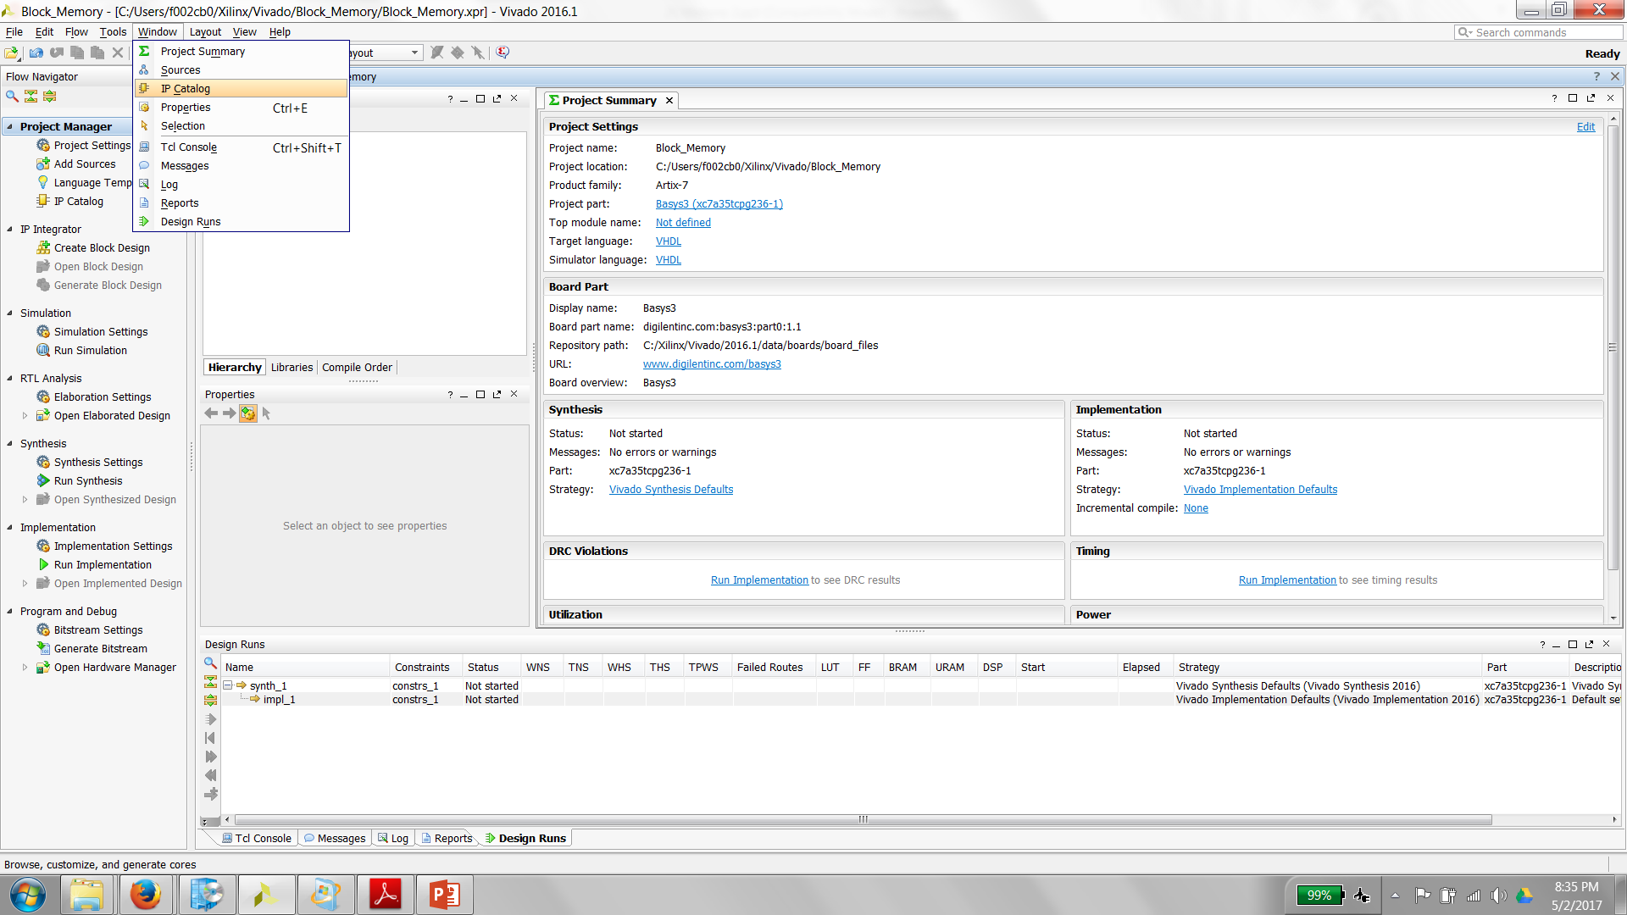
Locating the IP Cores

Slide 8
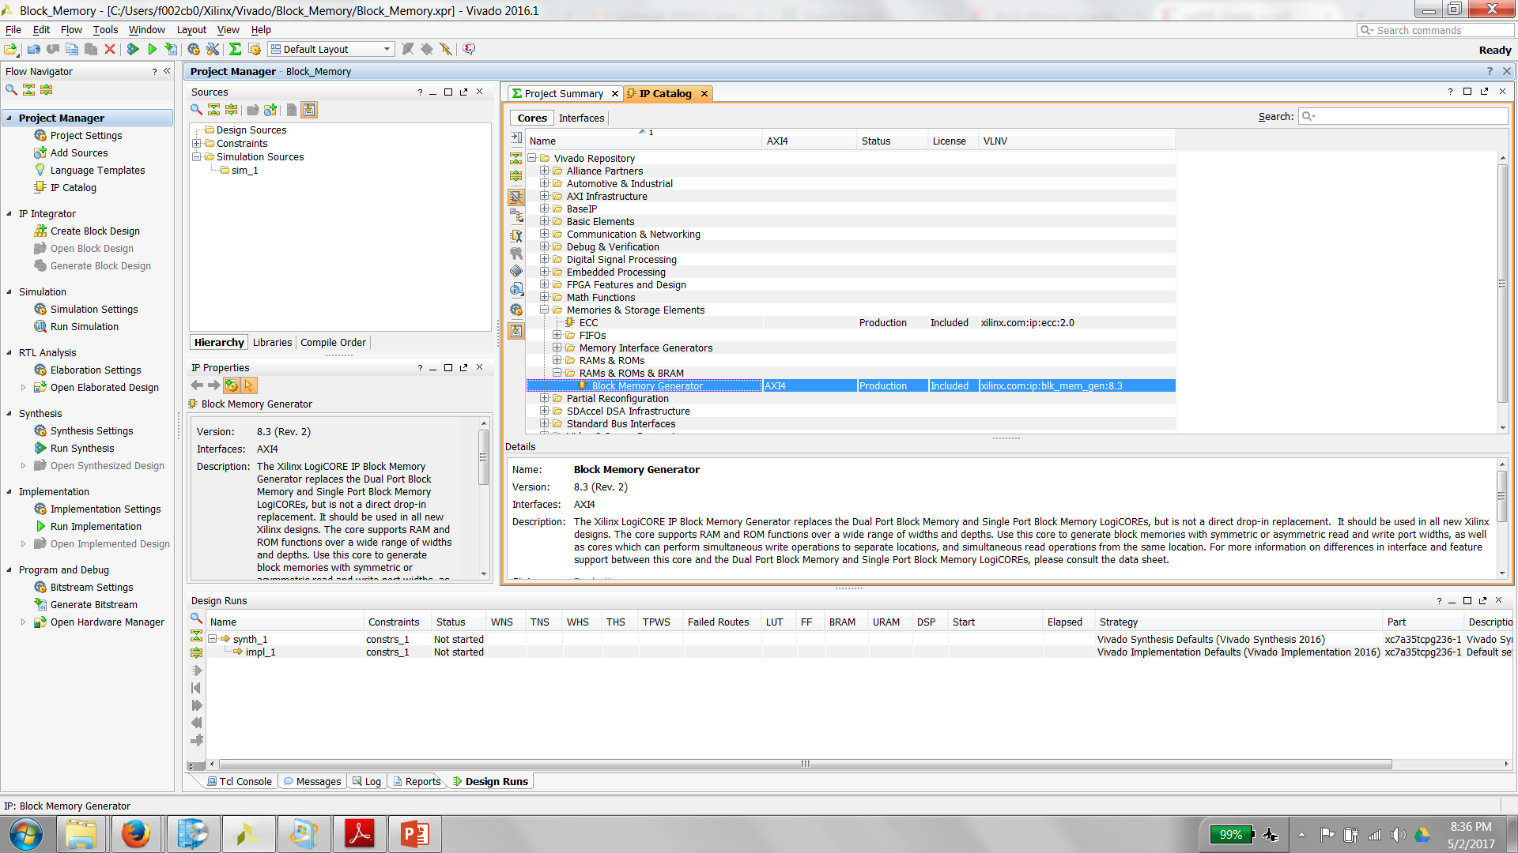
Selecting the Block ROM

Slide 9
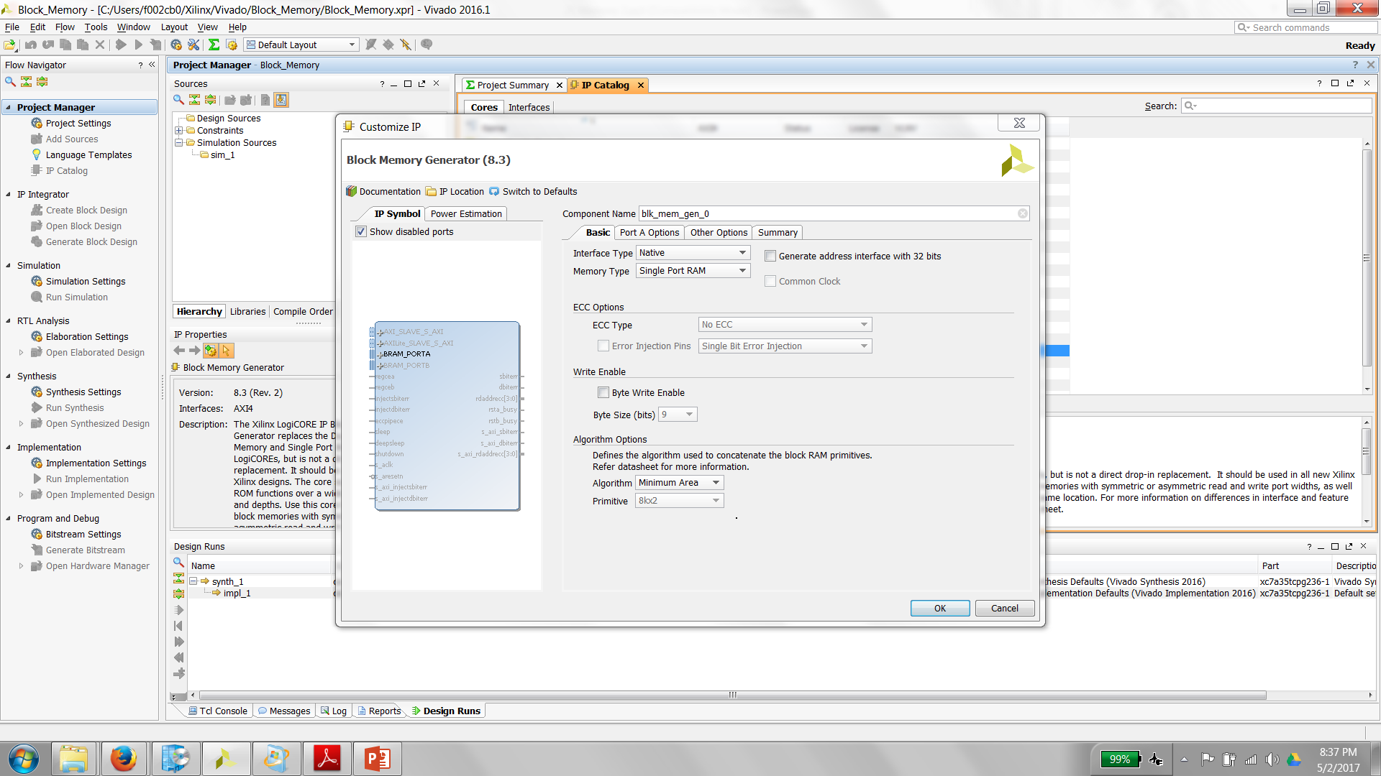
Block Memory Generator

Slide 10
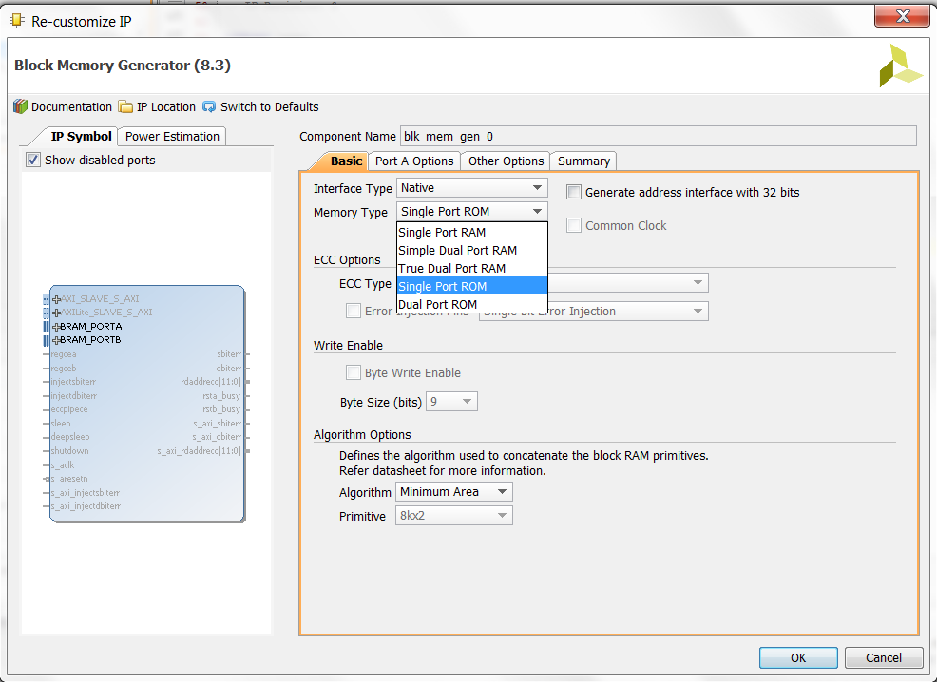
Specify that you want Single Port ROM

Slide 11
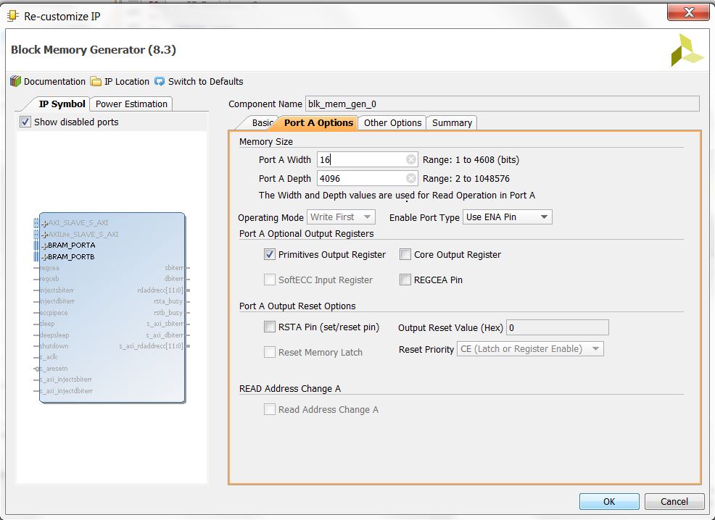
Specify Memory Size, use ENA pin

Slide 12

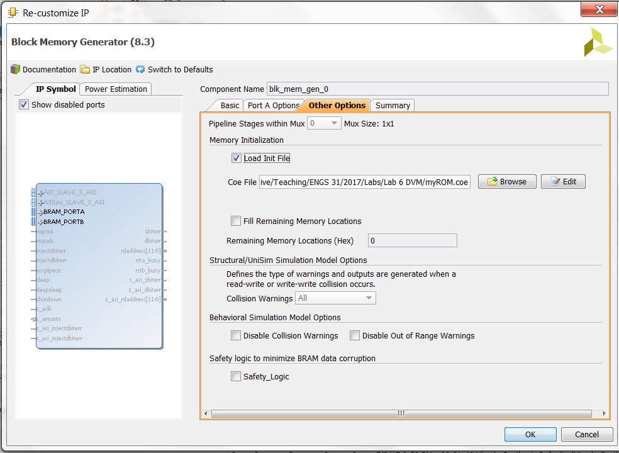
Preload the memory with data (required for ROM)

Slide 13
COE file format
Semicolon marks end of line / beginning of comment
; Sample COE file
; 4-bit binary to BCD converter
; EWH, Engs 31 08X
;
; memory_initialization_radix (2, 10, or 16) indicates whether the
; data are binary, decimal, or hexadecimal
memory_initialization_radix = 16;
;
; memory_initialization_vector defines the contents of each memory element.
; Each value is LSB-justified, separated by white space or a comma, and in the
; radix defined by memory_initialization_radix. List is terminated by a semicolon.
; Long files can be generated by Excel or Matlab, with appropriate formatting
;
memory_initialization_vector =
00 01 02 03 04 05 06 07
08 09 10 11 12 13 14 15;
These are hexadecimal, e.g., 12 = 0001 0010
Can use Matlab to compute coefficients for a large ROM!
Notes:
Engs 31 / CoSc 56 — Digital Electronics
20. Block Memory 2

Slide 14
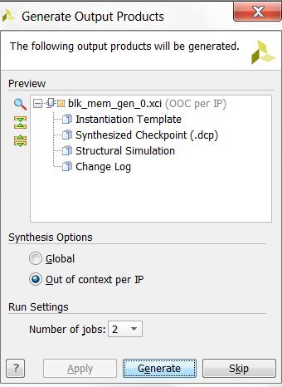
Generate the Memory (takes a couple minutes)

Slide 15
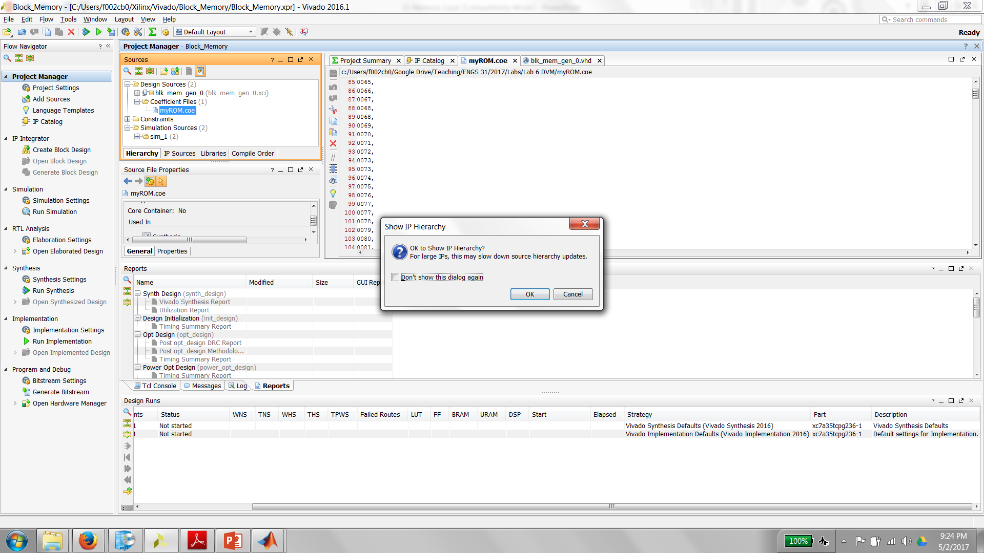
Expand the hierarchy to see what you created

Slide 16
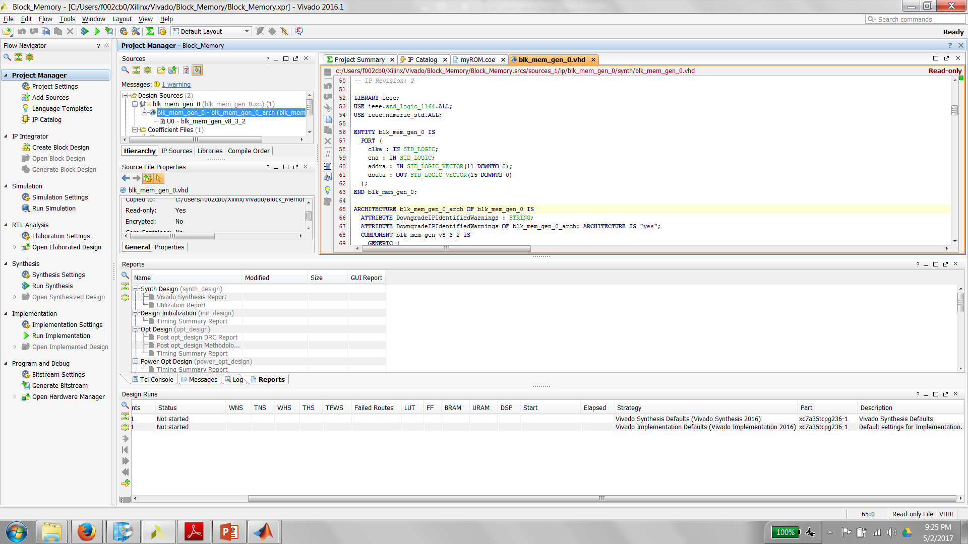
Entity in the VHDL file shows you how to wire it up

Slide 17
Instantiate the core into the top level VHDL file
Follow the usual structural VHDL method
component BlockROMdemo -- copied from BlockROMdemo.vho
  port (
    clka: IN std_logic;
    addra: IN std_logic_VECTOR(3 downto 0);
    ena: IN std_logic;
    douta: OUT std_logic_VECTOR(7 downto 0) );
end component;
…
Binary2BCD: BlockROMdemo -- copied from BlockROMdemo.vho
  port map (
    clka => clk50, -- usual structural VHDL port mappings
    addra => binary_in,
    ena => rom_enable,
    douta => bcd_out );
Notes:
Engs 31 / CoSc 56 — Digital Electronics
20. Block Memory 2

Slide 18
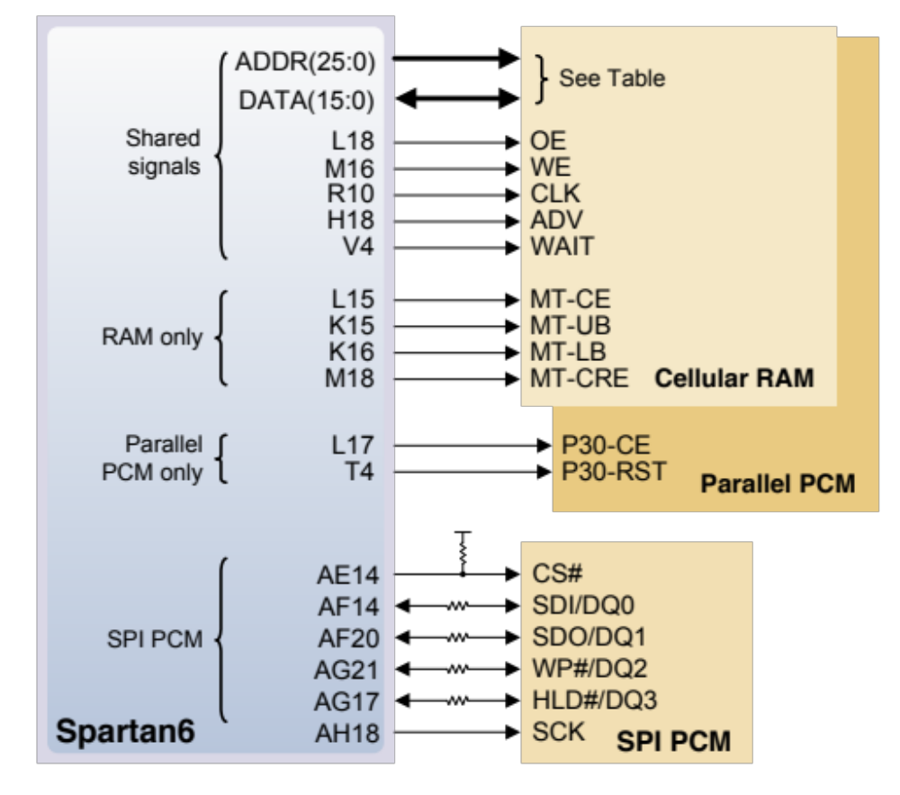
Memory chips on the Nexys 3 board (similar on BASYS 3)
RAM: 23 address bits (22:0)
⇒ 2²³ = 8 × 2²⁰ = 8 M addresses
Each memory location is 16 bits (2 bytes).
Read/write control bits
Chip enable bit
UB & LB bits allow upper or lower bytes to be selected.
Memory is accessed via pins on the FPGA (UCF file).
Micron M45W8MW16
The data bus is bidirectional, and it can be driven both by RAM and ROM (how does that work?)
Notes:
Engs 31 / CoSc 56 — Digital Electronics
20. Block Memory 2

Slide 19
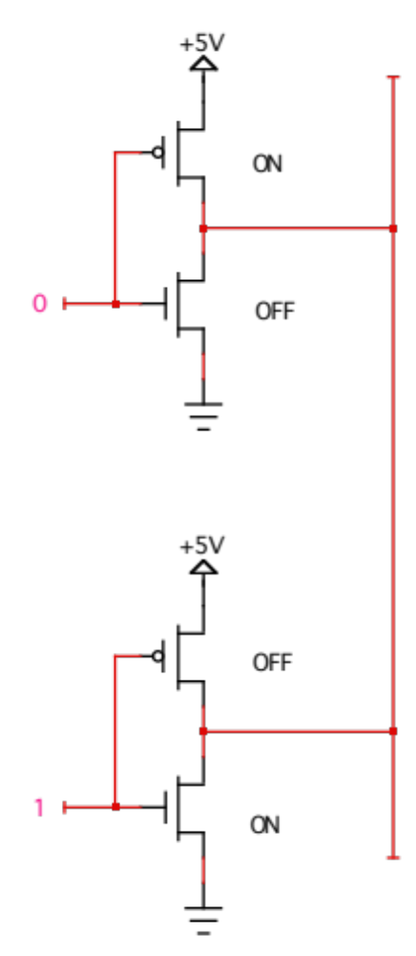
Ordinary logic outputs cannot be bussed together
One output tries to pull the bus up (sourcing current).
The other output tries to pull the bus down (sinking current).
Bus state is uncertain.
Energy is dissipated as heat in the chips.
Notes:
Engs 31 / CoSc 56 — Digital Electronics
20. Block Memory 2

Slide 20
Tri-state logic gates
Source: Brown & Vranesic
In addition to ‘0’ and ‘1’ define a third state: ‘Z’ — high impedance — infinite resistance, no connection.
Tri-state gates have a second input, Output Enable (OE).
  When OE is high, this gate is a non-inverting “buffer”.
  When OE is low, it is as though the gate is disconnected from
  the output!
  Many chips are equipped with tri-state output buffers.
OE
x
f
0
0
Z
0
1
Z
1
0
0
1
1
1
OE
OE
x
x
f
f
Notes:
Engs 31 / CoSc 56 — Digital Electronics
20. Block Memory 2

Slide 21
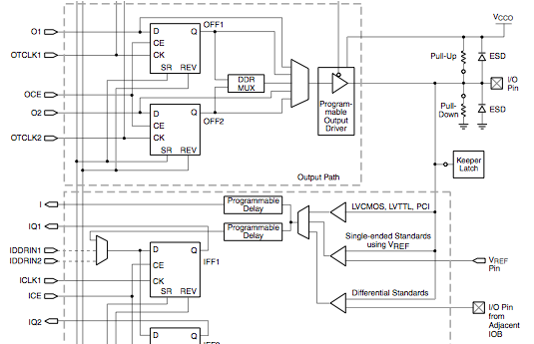
Bidirectional pins on FPGAs
Tri-state control
Pin can be input or output
Source: Xilinx
Notes:
Engs 31 / CoSc 56 — Digital Electronics
20. Block Memory 2

Slide 22
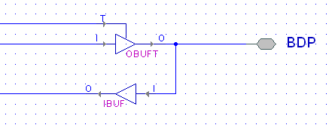
Bidirectional pins in VHDL
entity bidirectional_demo is
  port ( BDP : inout std_logic ); -- specify port is type “inout”
end bidirectional_demo;
architecture behavior of bidirectional_demo is
  signal sig_in, sig_out : std_logic;
begin
  sig_out <= output_expression; -- what the output will be
  …
  BDP <= sig_out when OE=‘1’ else ‘Z’; -- writing the pin
  -- OE is “output enable”
  sig_in <= BDP; -- reading the pin
end behavior;
Notes:
Engs 31 / CoSc 56 — Digital Electronics
20. Block Memory 2

Slide 23
Example: counter with bidirectional port
entity BidirPin is
port ( clk : in std_logic ;
oe : in std_logic; -- high-true output enable
preload : in std_logic; -- preload for counter
bdp : inout std_logic_vector(1 downto 0) ); -- bidirectional port
end BidirPin;
architecture Behavioral of BidirPin is
signal sig_in, sig_out : std_logic_vector(1 downto 0);
signal ctr : unsigned(1 downto 0) := "00";
begin
sig_in <= bdp; -- Read preload value from the port
process(clk) -- Preloadable counter
begin
if rising_edge(clk) then
if preload = '1' then
ctr <= unsigned( sig_in );
else
ctr <= ctr + 1;
end if;
end if;
end process;
sig_out <= std_logic_vector( ctr );
bdp <= sig_out when oe = '1' else "ZZ"; -- Write or tri-state the port
end Behavioral;
Notes:
Engs 31 / CoSc 56 — Digital Electronics
20. Block Memory 2

Slide 24
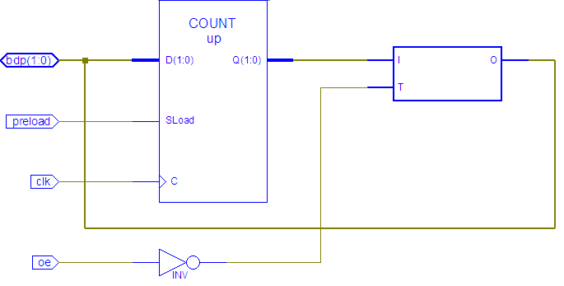
Counter with bidirectional port (2): RTL view
bidirectional port
tri-state buffer
Notes:
Engs 31 / CoSc 56 — Digital Electronics
20. Block Memory 2

Slide 25
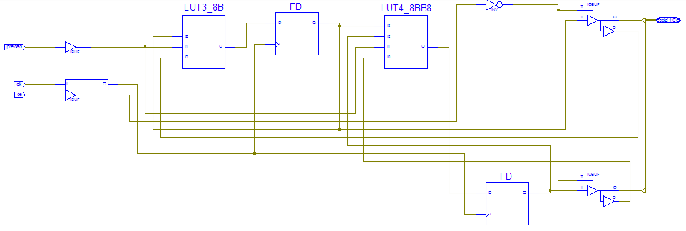
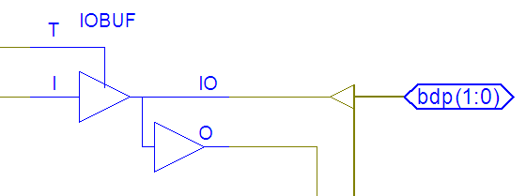
Counter with bidirectional port (3): Technology view
output path
input path
Notes:
Engs 31 / CoSc 56 — Digital Electronics
20. Block Memory 2

Slide 26
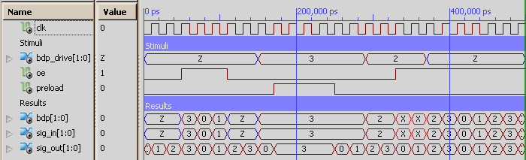
Counter with bidirectional port (4): Simulation
drive preload value onto bus
output
disabled
port driven
and enabled
→conflict!
output
enabled and port undriven:
count→out
counter preloaded
Notes:
Engs 31 / CoSc 56 — Digital Electronics
20. Block Memory 2

Slide 27
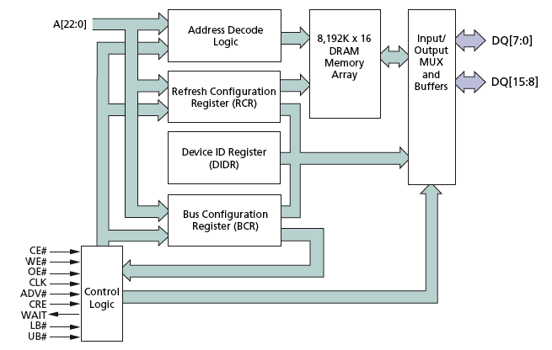
RAM chip on the Nexys 2 board
Chip is actually SDRAM, with internal electronics enabling it to operate either as a conventional asynchronous SRAM (easy) or as a synchronous memory (harder).
# indicates low-true
Source: Micron Technology www.micron.com
Notes:
Engs 31 / CoSc 56 — Digital Electronics
20. Block Memory 2

Slide 28
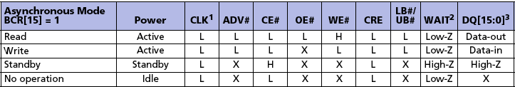
Reading and writing (asynch) SRAM
Source: Micron Technology
In read mode, SRAM behaves like ROM: data appears, asynchronously, after address is set up.
In write mode, SRAM behaves approximately like a transparent latch:
  Not edge-triggered
  Write is completed by asserting and deasserting WE#
LB#, UB# = access lower, upper data bytes
WE# = write enable
OE# = output enable
CE# = chip enable
SRAM control inputs
Notes:
Engs 31 / CoSc 56 — Digital Electronics
20. Block Memory 2

Slide 29
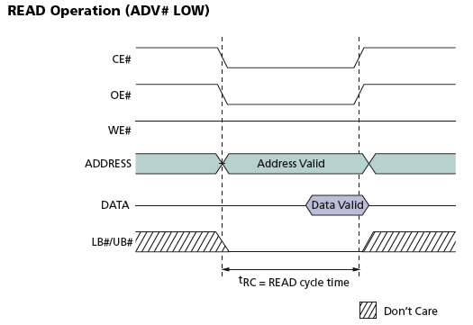
Reading and writing (asynch) SRAM
Source: Micron Technology
Update address
CE#, OE#
LB# / UB#
(wait t_{AA})
CE#, OE#
LB# / UB#
Load data from bus
For detailed timing, consult data sheet.
Notes:
Engs 31 / CoSc 56 — Digital Electronics
20. Block Memory 2

Slide 30
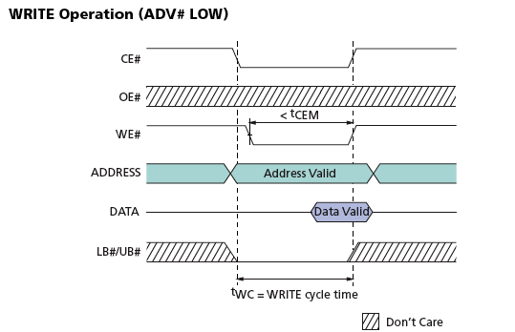
Reading and writing (asynch) SRAM
Source: Micron Technology
Update address
Update data
WE# like enable of a transparent latch.
CE#, WE#
LB# / UB#
(wait t_{CEM})
CE#
LB# / UB#
For detailed timing, consult data sheet.
Notes:
Engs 31 / CoSc 56 — Digital Electronics
20. Block Memory 2

Slide 31
Making wider memories out of smaller ones
Source: Katz
8K × 16 subsystem
One chip contains the “high byte” (D15:D8), and the other contains the “low byte” (D7:D0).
Both chips are identically addressed and enabled.
2764
2764
+
VPP
+
VPP
PGM
PGM
A12
A12
A11
A11
A10
O7
A10
O7
A9
O6
A9
O6
A8
O5
A8
O5
A7
O4
A7
O4
A6
O3
A6
O3
A5
O2
A5
O2
A4
O1
A4
O1
A3
O0
A3
O0
A2
A2
A1
A1
A0
U3
A0
U2
CS
CS
OE
OE
/CS
/OE
A12:A0
D15:D8
D7:D0
Notes:
Engs 31 / CoSc 56 — Digital Electronics
20. Block Memory 2

Slide 32
Making deeper memories out of smaller ones
Source: Katz
16K × 8 subsystem
One chip stores the low addresses (0-8191) and the other stores the high addresses (8192-16383)
A13 selects (/CS) one of the 8K × 8 chips. /CS overrides /OE and ensures that only one chip is active on the bus.
A12:A0 select a byte within the selected chip.
Outputs are bussed together with tri-state buffers. Output Enable (/OE) input places entire subsystem on and off the bus.
2764
+
VPP
PGM
A12
A11
A10
O7
A9
O6
A8
O5
A7
O4
A6
O3
A5
O2
A4
O1
A3
O0
A2
A1
A0
U3
/OE
CS
OE
A13
A12:A0
D7:D0
2764
+
VPP
PGM
A12
A11
A10
O7
A9
O6
A8
O5
A7
O4
A6
O3
A5
O2
A4
O1
A3
O0
A2
A1
A0
U1
CS
OE
Notes:
Engs 31 / CoSc 56 — Digital Electronics
20. Block Memory 2

Slide 33
Making wider and deeper memories
Source: Katz
16K × 16 subsystem
A13 selects (/CS) one of the 8K × 16 banks.
A12:A0 select a word within the selected bank.
2764
VPP
2764
+
PGM
+
VPP
PGM
A12
A12
A11
A11
A10
O7
A10
O7
A9
O6
A9
O6
A8
O5
A8
O5
A7
O4
A7
O4
A6
O3
A6
O3
A5
O2
A5
O2
A4
O1
A4
O1
A3
O0
A3
O0
A2
A2
A1
A1
A0
U3
A0
U2
/OE
CS
CS
OE
OE
A13
A12:A0
D15:D8
2764
2764
D7:D0
+
VPP
+
VPP
PGM
PGM
A12
A12
A11
A11
A10
O7
A10
O7
A9
O6
A9
O6
A8
O5
A8
O5
A7
O4
A7
O4
A6
O3
A6
O3
A5
O2
A5
O2
A4
O1
A4
O1
A3
O0
A3
O0
A2
A2
A1
A1
A0
U1
A0
CS
CS
U0
OE
OE
Notes:
Engs 31 / CoSc 56 — Digital Electronics
20. Block Memory 2

Slide 34
Summary
Differences between RAM and ROM.
Differences between on-chip block memory and off-chip block memory:
  Capacity: 576 Kbit vs 128 Mbit
  Speed: <3 ns vs 70 ns
  How to incorporate into a design
Bidirectional and tri-state pins for busses.
If you need RAM or ROM in your project, see me.
Much more about using external RAM and ROM: see Engs 62 (microprocessors)
Notes:
Engs 31 / CoSc 56 — Digital Electronics
20. Block Memory 2

